Slide 1


Smart Home Security and Safety System with Motion and Smoke detection
To create a Security and Safety System by which tasks will be performed by a microcontroller allowing remote monitoring and control of the system via IoT.
Prepared by: Matthew Gertze
Student Nr: 221014047
Bachelor of Electronics and Telecommunications Engineering
21/05/2024

Slide 2
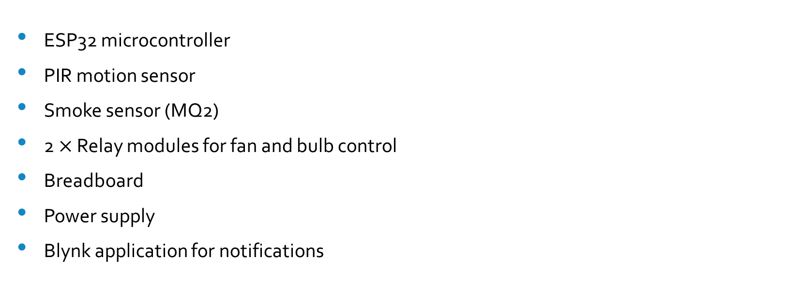
System Components
ESP32 microcontroller
PIR motion sensor
Smoke sensor (MQ2)
2 $×$ Relay modules for fan and bulb control
Breadboard
Power supply
Blynk application for notifications

Slide 3
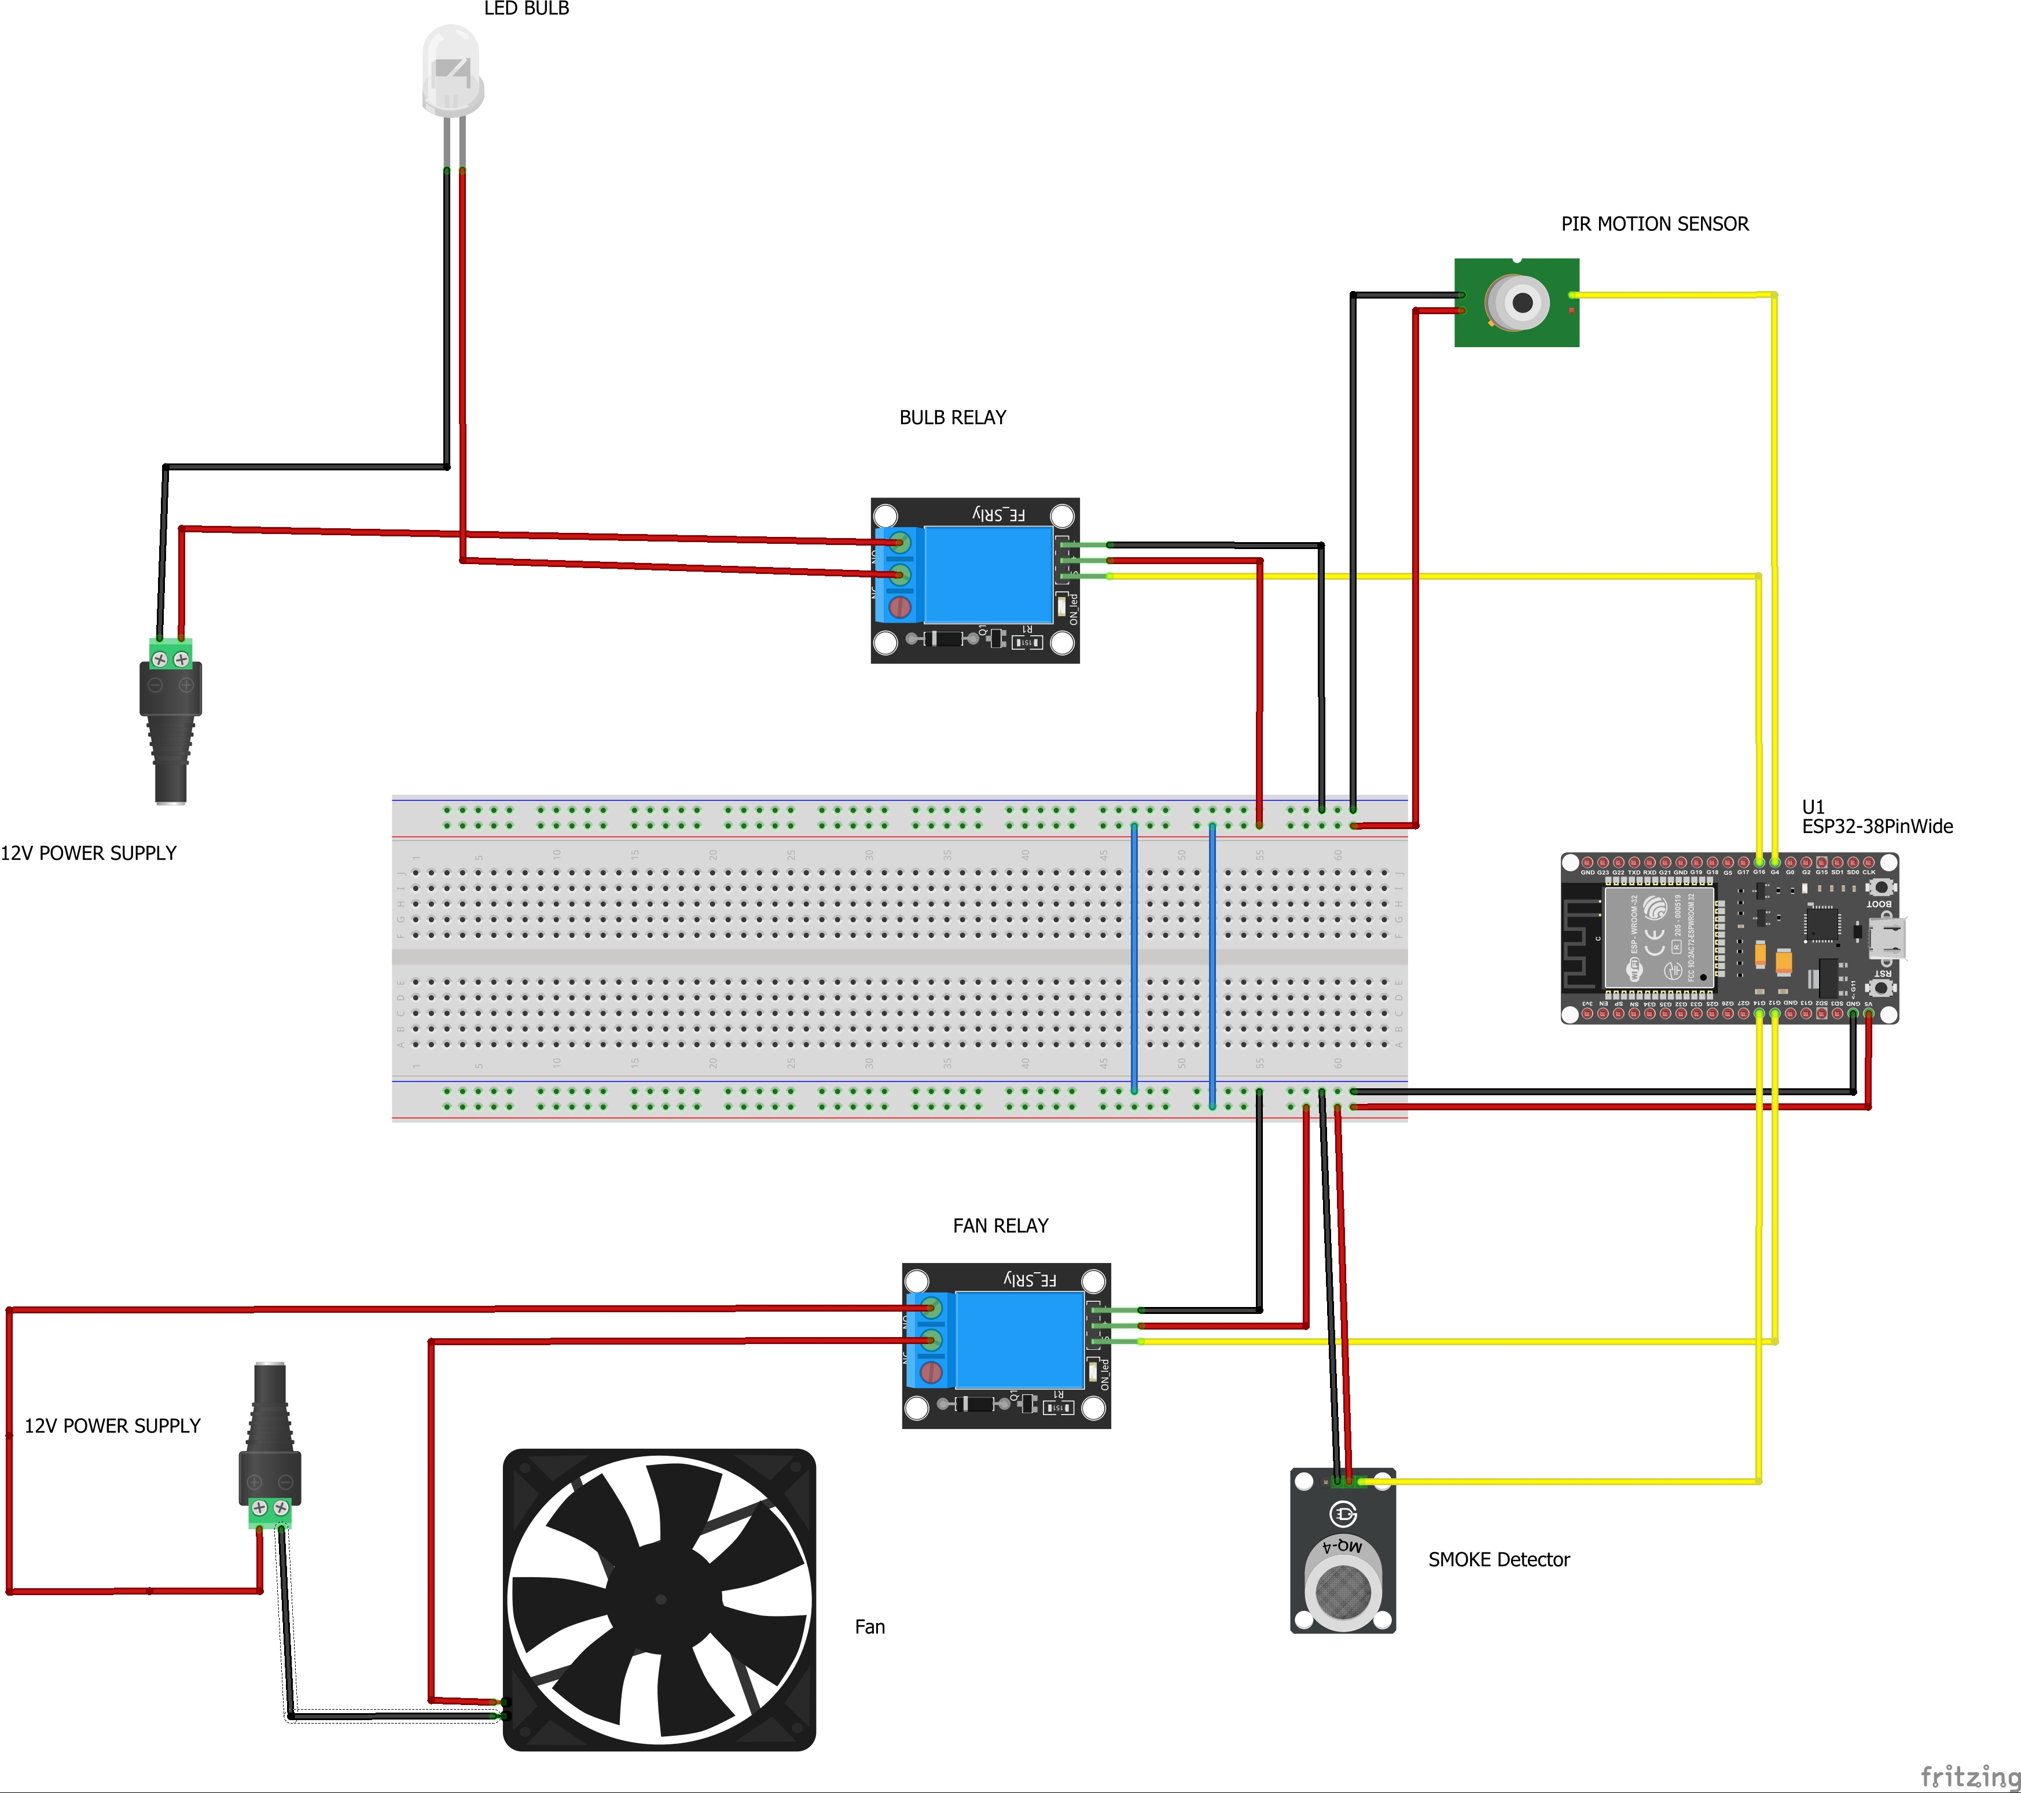
Schematic Diagrams

Slide 4
Benefits and Applications
Real time alerts
Enhanced Security
Remote monitoring
This security system can be used in homes, offices and warehouses.

Slide 5

Inspiration for The Project
Home Security and Safety Enhancement:
The rising need for smart home solutions that enhance security and safety motivated the project. Combining motion detection with smoke detection addresses both security breaches and potential fire hazards.
Cost-Effective Solution:
Creating an affordable and accessible home security and safety system using readily available components.
Convenience and Control
The desire to remotely monitor and control home systems through smartphones inspired the use of the Blynk app.

Slide 6
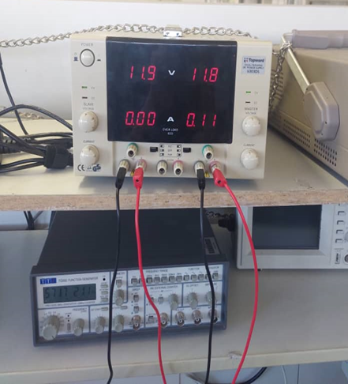
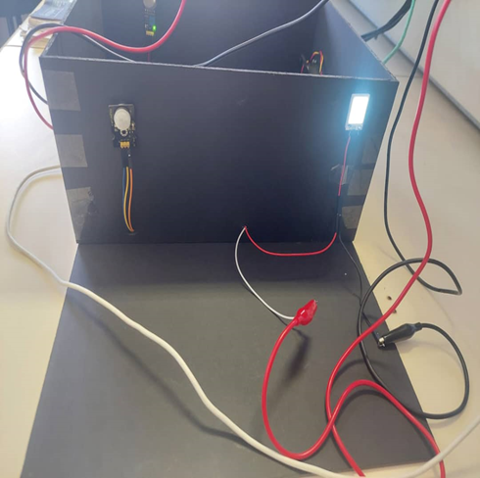
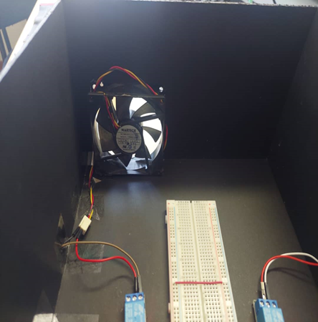
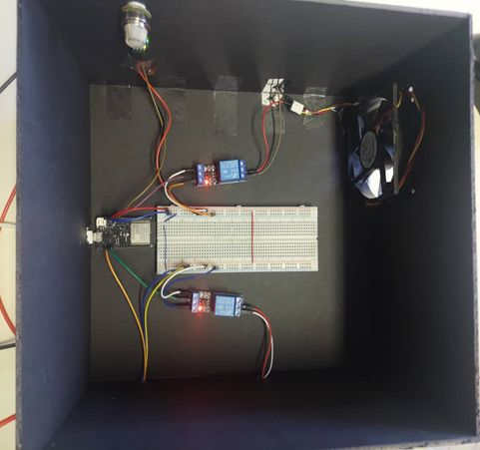
Results

Slide 7
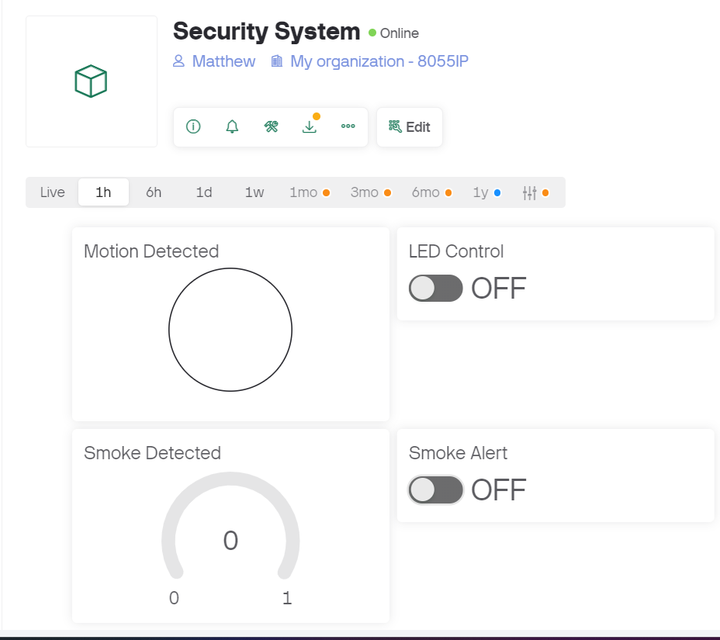
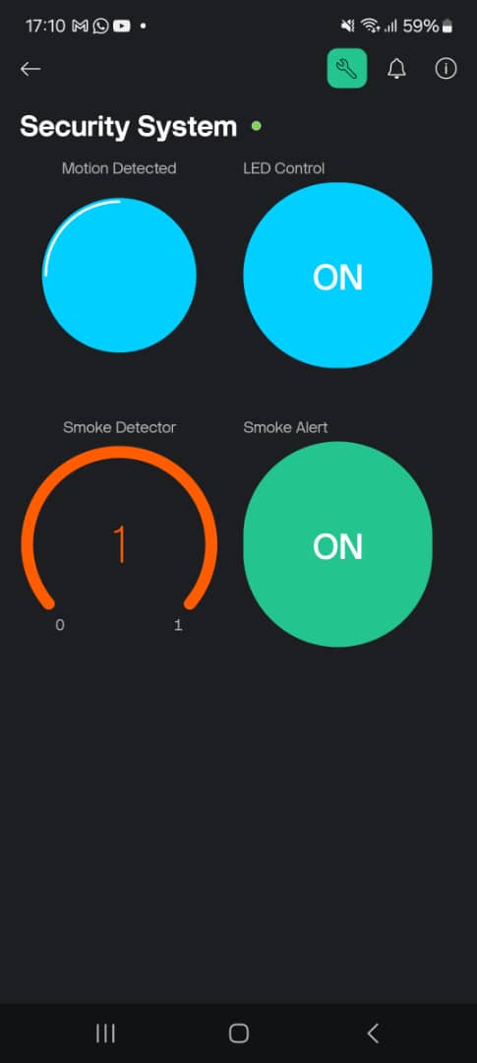
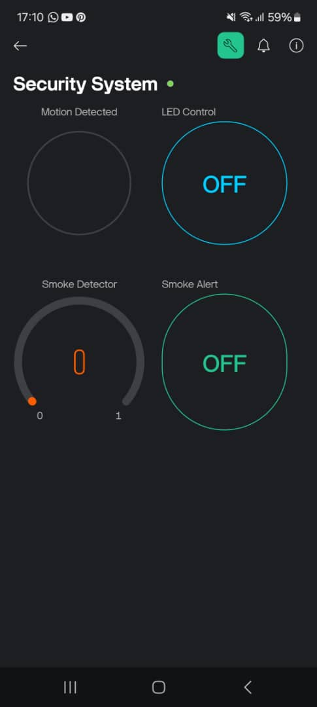
Results

Slide 8
Procedures
The design of the proposed system will be divided into four phase.
Phase 1: Involved the planning and purchasing of components.
Phase 2: To simulate using the ESp32 to test the program in the early stages of the project.
Phase 3: Testing code each component separately and combining of code.
Phase 4: Assembling and Packaging of the project.

Slide 9
SWOT Analysis
Strengths
Remote monitoring
Remote control
Scalability
Offline Capability
Weakness
Dependency on Wi-Fi for IoT functionality
Opportunities
Feature Improvement
Educational Tool
Threats
Reliability issues

Slide 10

Conclusion
In conclusion, this project demonstrates the integration of motion and smoke detection with real-time notifications to create a smart Home Security and Safety System.

Slide 11
Recommendations
Enhancing the Blynk app's user interface to provide more detailed analytics and user-friendly controls.
Investigating different IoT platforms for comparison and possible integration.
Find more ways to improve Blynk’s response time when showing if the system is online.
Integration more sensors like a temperature and humidity (DHT11) sensor and door/window sensor and more actuators into the system.

